Slide 1

ALGORITHMS
PROJECT 2

Slide 2
TABLE OF CONTENTS
01
04
02
05
03
06
MULTISOURCE BFS
TIME COMPLEXITIES
Introduction; BFS vs Multi Source BFS
Time Complexity analysis for the two implementations
ALGORITHM: a AND b
EMPIRICAL RESULTS
Implementation for parts a and b
Run time data by tweaking the variable values; Conclusion
ALGORITHM: c AND d
LIVE DEMO & Q/A
Implementation for parts c and d
Demonstration of our codes followed by QnA

Slide 3
INTRODUCTION
Given an undirected unweighted graph G, which represents a city’s road network with n nodes being intersections/endpoints and e edges being roads. Among the n nodes, h of them are hospitals. Find, for each node, the distance (i.e., the number of edges in the shortest path) from each node to the nearest hospital where ‘h’ could take any value from 1 to n.
Design an algorithm for computing the distance from each node in G to its nearest hospital. Output the distance and the shortest path for each node to a file.
Design an algorithm to complete the task (a) but it’s time complexity should not depend on the total number of hospitals h.
Find the distances to top-2 nearest hospitals from each node.
Propose an algorithm that works generally for computing the distances from each node to top-k nearest hospitals for an input value of k.

Slide 4
TEST DATA
We have tested our he large-scale real road networks downloaded from snap.stanford website.
California Road Network:
Nodes: 1.96 million; File Size: 86 MB
Texas Road Network Subset:
Nodes: 1 million; File Size: 39 MB
Pennsylvania Road Network Subset:
Nodes: 200,000; File Size: 8 MB

Slide 5
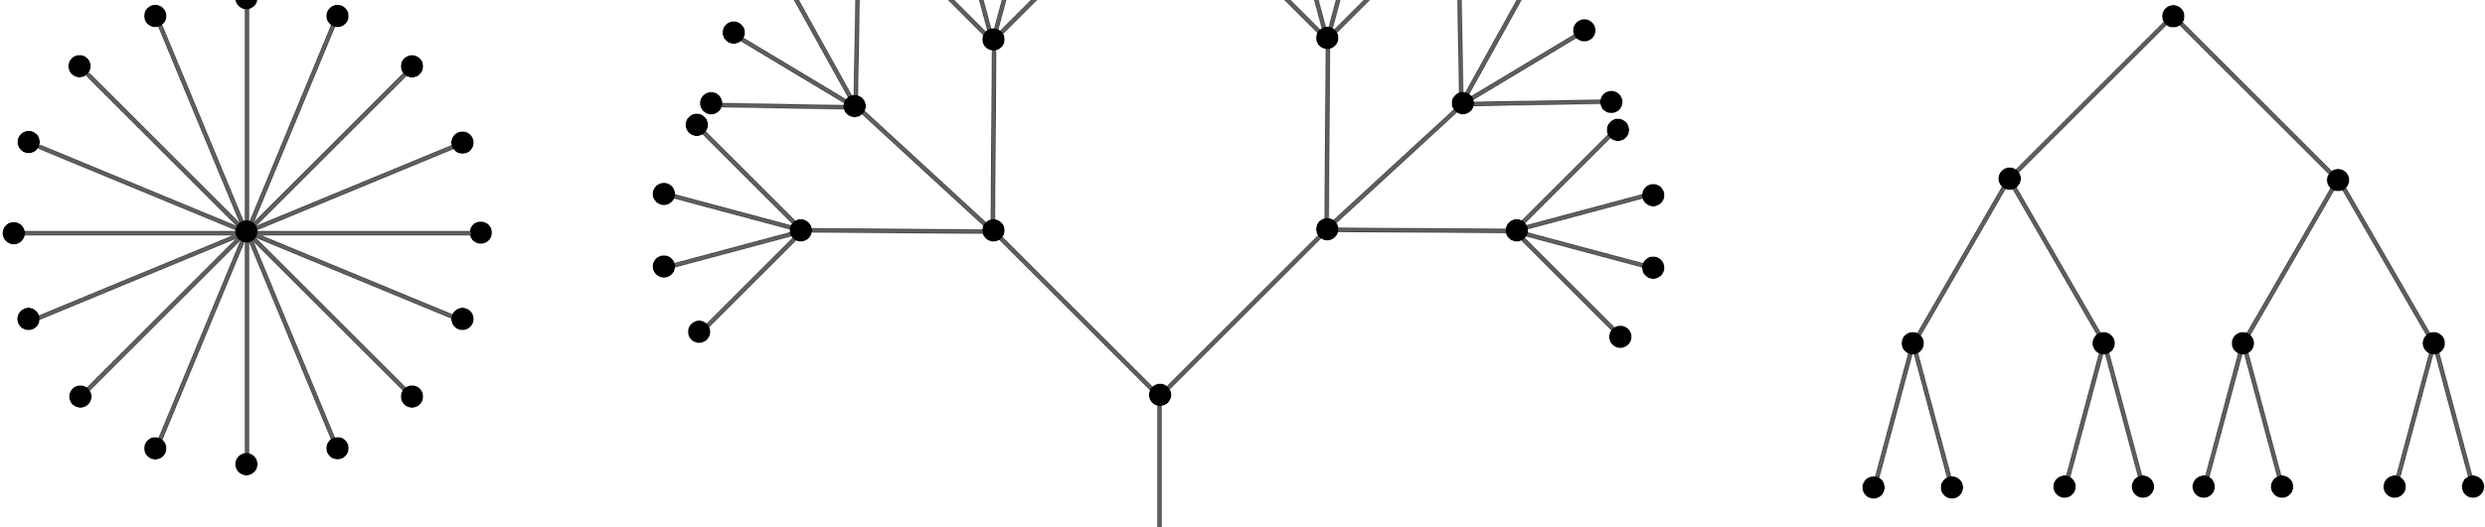
01
MULTI SOURCE BFS

Slide 6
MULTI SOURCE BFS
Utilize the uniqueness of BFS, searching by its neighbouring nodes before proceeding to the next depth level.
Unlike normal BFS, multi-source BFS, after searching all its neighbouring nodes, instead of proceeding down to the next level, it will proceed to the next source node and continues from the depth level where it left off
Source node (h): B, J, E
Queue model for Multi-Source BFS
B,J,E
Nodes that are depth level 1 of B,J,E (1st iteration)
Nodes that are depth level 2 of B,J,E (2nd iteration)
Nodes that are depth level 3 of B,J,E (3rd iteration)
F
G
A
B
H
E
I
C
J
D

Slide 7

02
IMPLEMENTATION: a AND b

Slide 8
IMPLEMENTATION: a AND b
Add all hospital nodes into queue
Carry out BFS for each and every hospital node one level at a time
Repeat 1 and 2 until all nodes have been visited
Case1: Node has no other adjacent nodes to be traversed
-> try and except to catch the error when we try to look for its adjacent nodes
Case2: Node has been visited
-> the node is skipped as the nearest hospital is found
Case3: Node not visited
-> Indicated nearest hospital found, update distance, add node to queue to traverse the adjacent nodes

Slide 9
03
IMPLEMENTATION: c AND d

Slide 10
IMPLEMENTATION: c) AND d)
This is an extension of a) and b), with the difference being the number of times a node is allowed to be visited.
In the previous case, every node could be visited a maximum of 1 time. In contrast, in this case, every node can be visited a maximum of k times, where k is the number of nearest hospitals we are trying to find.
We can definitively say this because we use BFS from each root node.

Slide 11
IMPLEMENTATION: c AND d
At the same time, a node cannot be revisited from the same source node.
However, a node that has already been visited by 1 root, can still be visited from another root, given that this node has not already identified its k nearest hospitals.
If the node has been visited k times already, then it is marked as a dead end and is not traversed further.
This is because if this node has already been visited by k roots, then all of its children have also explored k times by the time the current search reaches it.
Traversal ends when all the roots have no more nodes left to traverse, or when all of their queues are empty.

Slide 12
IMPLEMENTATION: c) AND d)
Hence there are 3 distinct cases when traversing the graph through one of the roots:
Case 1 : Encounter a node that has already been traversed by this root
In this case, we skip searching this node and any of its children.
Case 2 : Encounter a node that has not been traversed, but has already found its k nearest hospitals:
In this case, the node is skipped and marked as a dead end.
Case 3 : Encounter a node that has not been traversed, and has not found its k nearest hospitals:
In this case, we indicate that one of the k nearest hospitals for this node is the root of the current BFS search.
We also prepare to search the children of this node in the next iteration.
We also place a mark on this node to ensure it is not visited again under the current search.

Slide 13

04
TIME COMPLEXITY ANALYSIS

Slide 14
TIME COMPLEXITY ANALYSIS: a AND b
For part a) and b), the hospital source node needs to traverse through all the nodes to obtain the shortest path of each node relative to the hospital source node location.
In an adjacency dictionary, every node is processed once while every edge is considered twice for an undirected graph. The time complexity will ignore the constant 2 from O(n + 2e), hence the asymptotic time complexity is O(n + e).

Slide 15
TIME COMPLEXITY ANALYSIS: c AND d
For parts ‘c’ and ‘d’, the variable ‘k’ is included in the time complexity which essentially is the number of nearest hospitals that each node must find.
As ‘k’ increases, each node must find and store ‘k’ number of hospitals and paths in hFound.
For every node n and edge e, it will be explored k times, making the time complexity independent of h.
Combining this concept with the basic time complexity of BFS, we get the asymptotic time complexity of our proposed algorithm to be O(k(n + e)), which is further backed by the empirical results.

Slide 16
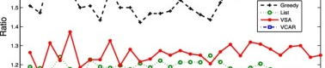
05
EMPIRICAL ANALYSIS

Slide 17
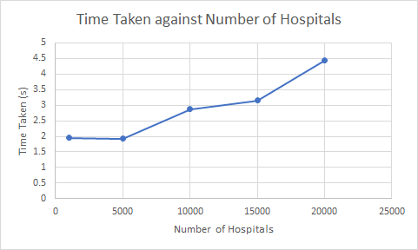
EMPIRICAL ANALYSIS: h
Used a file with 100,000 nodes and keeping k as 1 and varying the number of hospitals from 1000 to 20000 at intervals of 5,000.The time v/s h-input plot is shown below:
The time taken for the algorithm does not vary much with the varying number of hospitals. The neighbours of each hospital must be visited to determine the shortest path, hence the slight increase. But the algorithm’s time complexity is independent of h.
Notes:
The slight variations in the pattern can be attributed to the fact the queue is initialised with hospitals as the starting nodes and the neighbours of each hospital will be added to the queue.

Slide 18
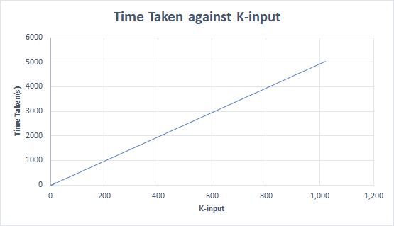
EMPIRICAL ANALYSIS: k
Used a file with 100,000 nodes, we used 5,000 nodes as hospitals and varied k-input from 1 to 1,000 in intervals of 50. The time v/s k-input plot is shown below:
As observed from the graph, the time taken to run is linearly dependent on k in concurrence with the theoretical deduction of time complexity i.e. O(k(n + e))

Slide 19
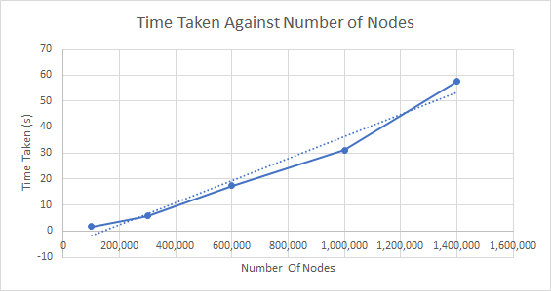
EMPIRICAL ANALYSIS: n+e
Used a file with nodes which varies from 100,000 to 1.4million which are randomly generated and fixed 5000 nodes as hospitals in each. K-input is also set to 1 for each file. The time v/s n-input plot is shown below:
It can be deduced from the data that the time taken for the algorithm increases linearly which checks out with the theoretical deduction of time complexity i.e. O(k(n + e)).

Slide 20

06
LIVE DEMO AND Q/A

